Slide 1



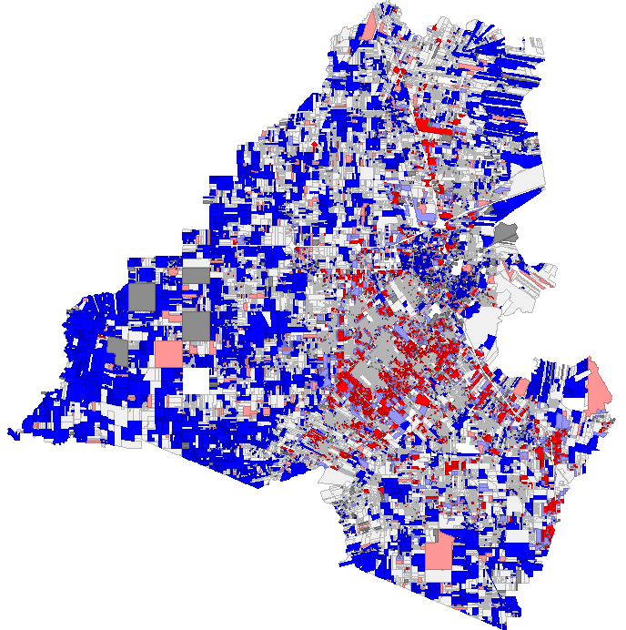
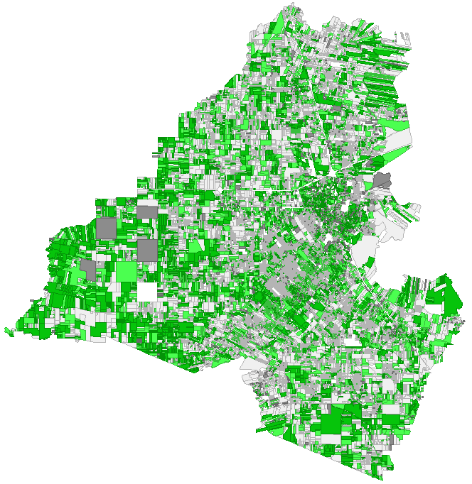
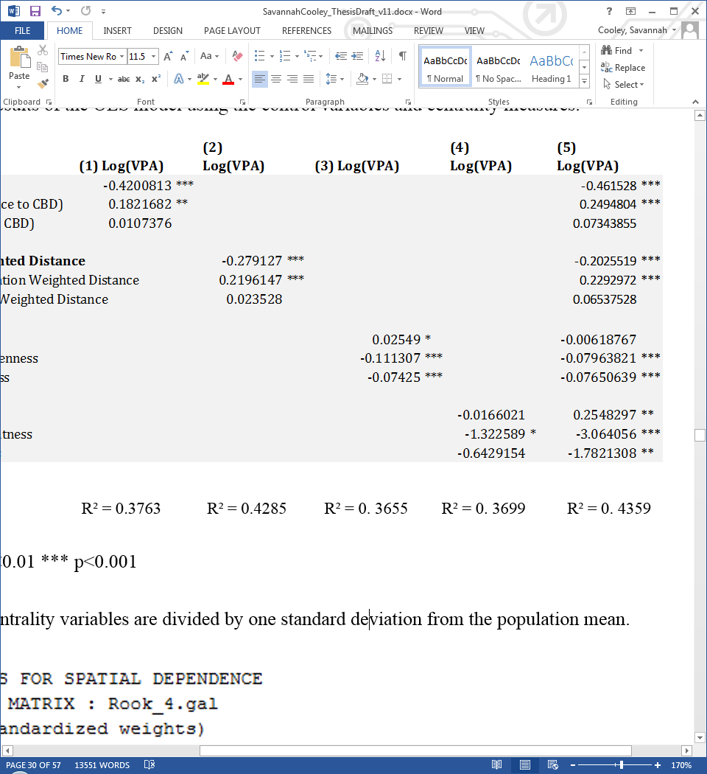
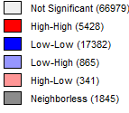
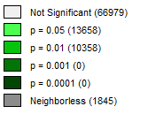
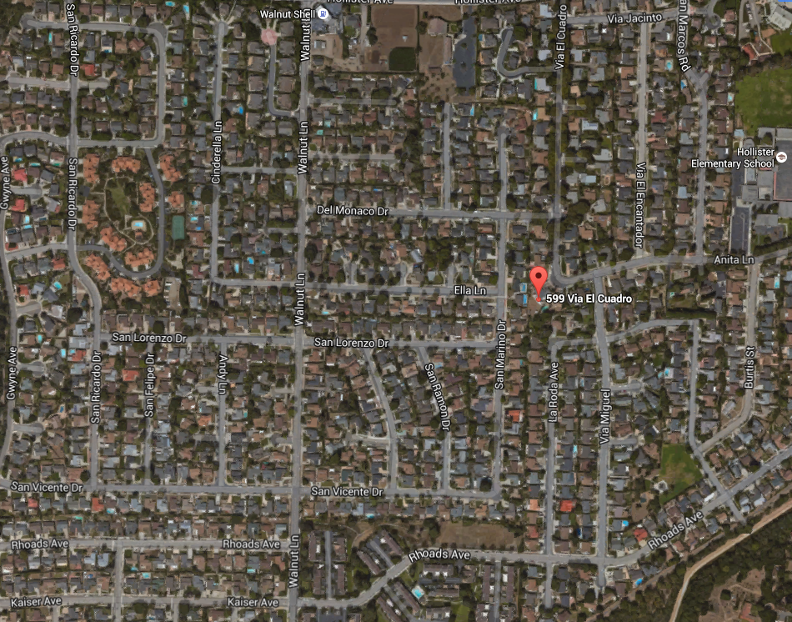

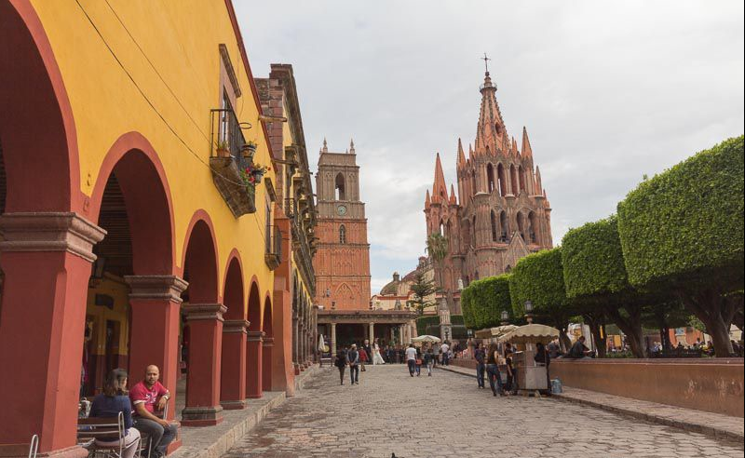
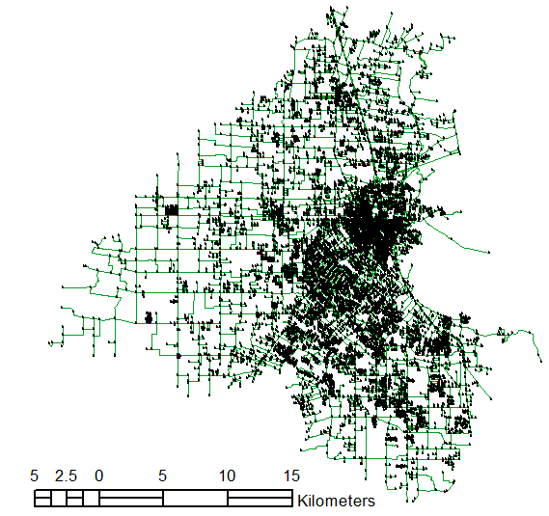
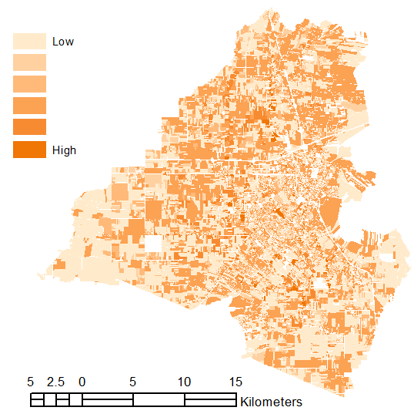
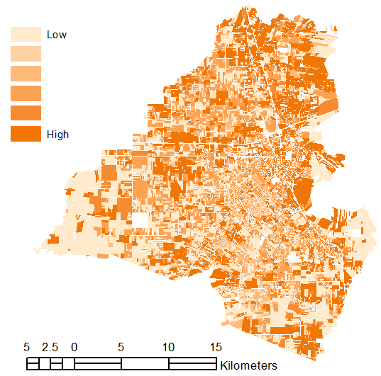
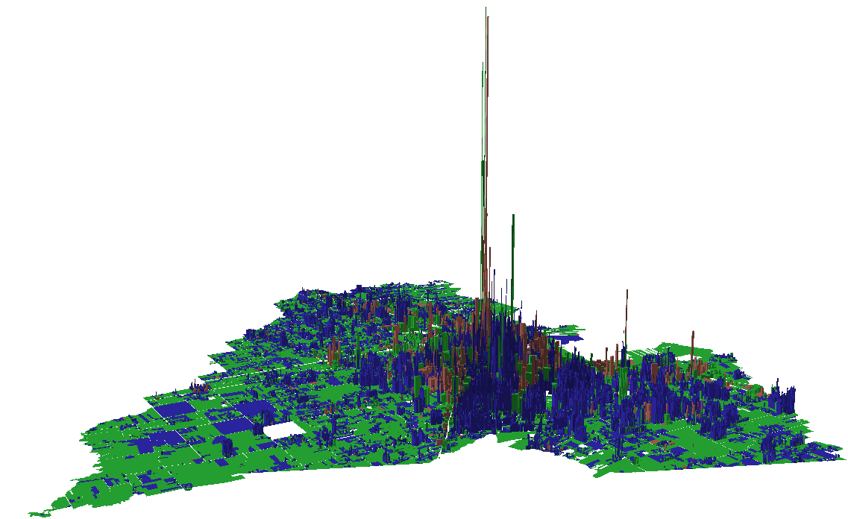
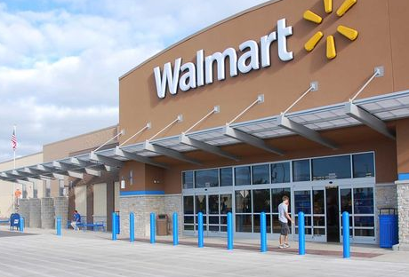
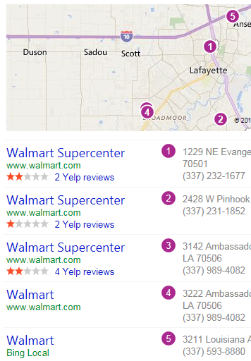
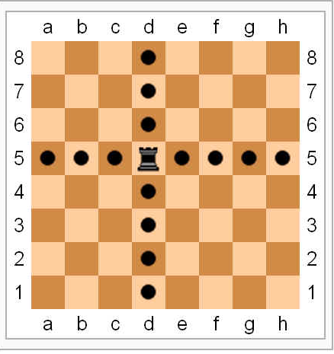
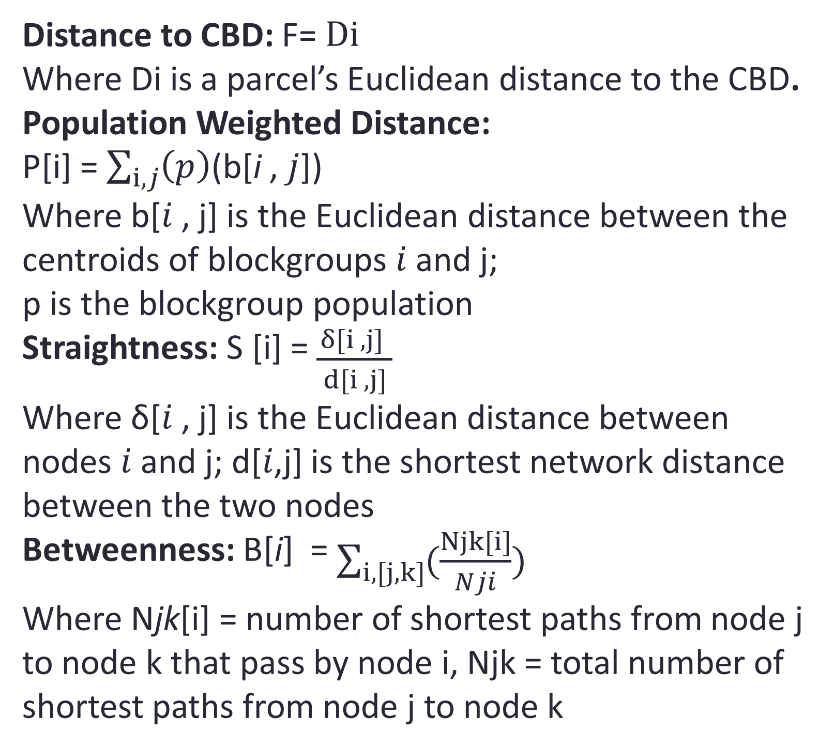
The Roles of Landuse and Centrality in Urban Land Productivity: An Empirical Study in Lafayette, Louisiana
Savannah Cooley, Department of Economics, Clark University
Joshua McCarty, Chief Analytics Researcher, Urban3
abstract
methods
results
This study explores the impact that landuse and centrality have on property values at the parcel level in Lafayette Parish, Louisiana. The spatial hedonic regression model developed serves to determine to what extent different centrality measures (distance to the central business district (CBD), population weighted distance, Betweenness and Straightness) affect land value per acre across residential, commercial and other property uses. Results indicate that all centrality measures were statistically significant for at least one landuse category. Increased centrality has a mostly positive impact on value per acre across all landuse categories when centrality measures are tested individually but shows mixed effects when centrality measures are combined into one model.
Spatial Autocorrelation?
Yes: Global Moran’s I = 0.158
Significant?
Yes: p<0.001
(a) OLS with control variables only
(b) OLS with control variables and centrality measures
Local Moran’s I:
VPA
Significance Map
Multi Collinearity?
Note: All centrality variables are divided by one standard deviation from the population mean.
 | Distance to CBD | Population Weighted Distance | Betweenness | Straightness
Distance to CBD | 1
Population Weighted Distance | -0.0339 | 1
Betweenness | -0.0278 | -0.0491 | 1
Straightness | 0.2111 | 0.0173 | 0.1413 | 1
Motivation
Centrality Measures
Spatial Lag or Spatial Error Model?
Distance to CBD: F= $Di$
Where Di is a parcel’s Euclidean distance to the CBD.
Population Weighted Distance:
P[i] = $\sum_{i, j}{\left(p\right)}$(b[i , 𝑗])
Where b[𝑖 , j] is the Euclidean distance between the centroids of blockgroups 𝑖 and j;
p is the blockgroup population
Straightness: S [i] = $\frac{δ[i , j] }{ d[i , j] }$
Where δ[𝑖 , j] is the Euclidean distance between nodes 𝑖 and j; d[𝑖,j] is the shortest network distance between the two nodes
Betweenness: B[i] = $\sum_{i, [j, k]}{(\frac{Njk[i]}{Nji}})$
Where Njk[i] = number of shortest paths from node j to node k that pass by node i, Njk = total number of shortest paths from node j to node k
I grew up here
← Suburbs of Santa Barbara, CA
…And then lived here for 4 years
Mixed Use Downtown of San Miguel, Mexico →
The monotony of suburbia prompted me to ask:
what else is possible in urban design?
“…promote development patterns that secure a community's fiscal condition while reinforcing a stronger sense of place”
-Urban3 Mission Statement
Road Network
Betweenness
Straightness
Research question
How do landuse patterns and centrality relate to a property’s market value per acre (VPA)?
Commercial
Spatial Lag Hedonic Regression Model
Conclusions
Residential
ln(VPA) = β0 + β1SpatialLag + β2DistanceToCBD + β3PopWeightedDistance + β4Straightness + β5Betweenness + β6Controls + e
Other
High value of centrally located commercial properties suggests that several market failures may distort the urban growth process in Lafayette
One limitation in this study relates to the lack of clear interpretation of the centrality coefficient magnitudes: only analyzing the signs and relative magnitudes of coefficients limits the ability of results to inform urban planning policy.
More qualitative research could improve understanding of how different centrality measures impact value per acre to inform community design policies.
Spatial Lag model chosen due to strong theoretical basis for spatial autocorrelation in value per acre
Interactive terms for residential and other landuses were applied to all variables to control for commercial
Rook-based contiguity chosen to minimize edge effects

